Slide 1

PUBLICATIONS BOOK
PRESTIGE SPRING RITUALS

Slide 2

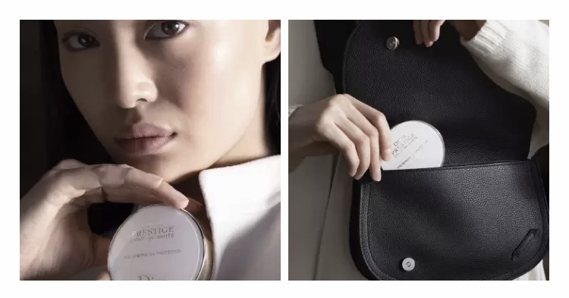
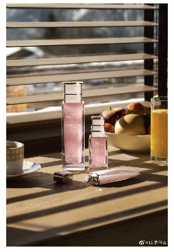
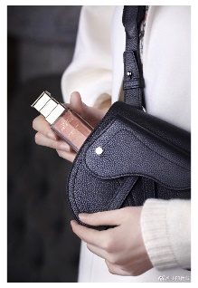
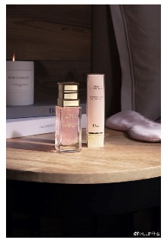
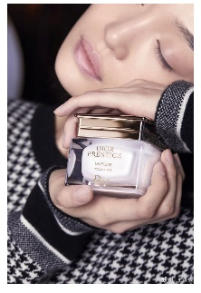
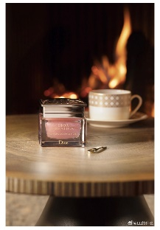
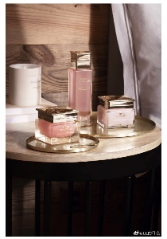
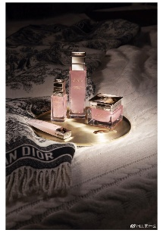
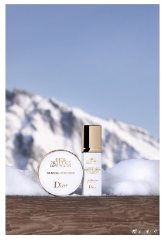
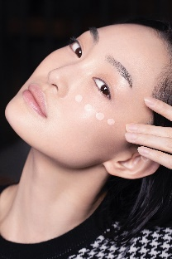
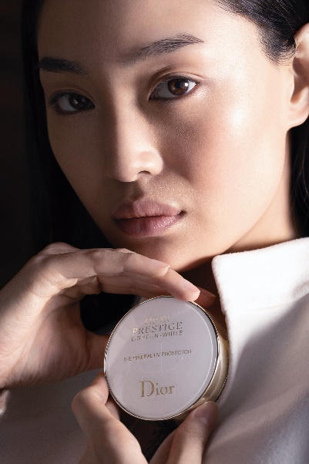
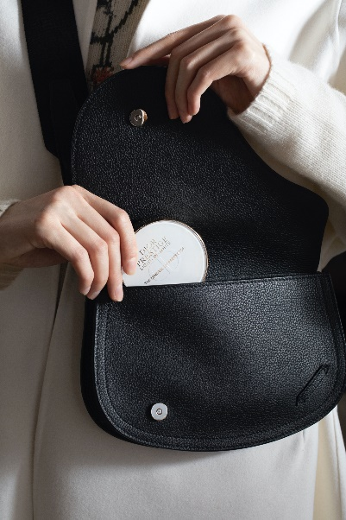

SKINCARE WEIBO
27th MARCH POST – PRESTIGE SPRING RITUALS
MOCKUP
WORDING
This spring’s on-the-go skincare essential: DIOR PRESTIGE LIGHT-IN-WHITE MINERAL UV. A travel-friendly, SPF50+ compact to carry anywhere. Its smooth cushion instantly covers the skin with a homogeneous, skin-perfecting veil. Protect your skin’s beauty, anytime, anywhere. #迪奥花秘瑰萃# #diorprestige# #迪奥护肤# Click the link for more:
LOCAL PUBLICATIONS
16/03
17/03
18/03
Skin-breakfast
Rose Oil
Rose Yeux
20/03
21/03
23/03
It’s the real preview of the visual in the Weibo Newsfeed.
Cream
Caviar
3 Step Ritual
24/03
25/03
26/03
Original visual below:
LANDING PAGE
Complete Ritual
UV Products
UV Protector
▼
27/03
http://on-pp.dior.com/weiboskin-prestigespringrituals-uvcompact
UV Compact
DIGITAL MEDIA TEAM
Notes:
https://www.dior.cn/zh_cn/%E6%8A%A4%E8%82%A4/%E6%8A%A4%E8%82%A4%E7%B3%BB%E5%88%97/%E8%8A%B1%E7%A7%98%E7%91%B0%E8%90%83%E5%85%89%E7%9A%99%E7%B3%BB%E5%88%97?utm_source=weiboskin&utm_content=prestigespringrituals_uvcompact_socialcrossdevices&utm_medium=social&utm_campaign=prestigespringrituals_cn_mar20

